Slide 1
Indian Currency Recognition
Under the Guidance of
PROF. SUBHASHIS CHATTERJEE
Presented by
Chinmay Sathe | 19MT0119

Slide 2
A little bit about the IDEA!
While recognizing any country’s currency, there seems to be a huge gap between visually impaired and a normal visioned person.
The idea is to reduce this gap for Indian currency by proposing a deep learning based currency recognition system.
By collecting data from various sources, a convolution neural network will be trained to extract features from the images.
Later, an object detection algorithm, will take earlier extracted features into consideration while classifying a denomination.

Slide 3
Inspiration for this idea
Money is important to everyone, if someone speaks otherwise then either they are lying or they are rich.
A thing of such importance needs to be evaluated correctly by a person.
Imagine it takes you a lot of efforts to procure money, every single time, just because you simply are unable to recognize the denomination as quickly as others.
That is exactly what visually impaired people go through DAILY.
As an Engineer and now a budding data scientist it is our sole duty to make people’s life easier, hence this PROJECT.

Slide 4

Who will benefit from the idea ?
Blind or Visually Impaired People

Slide 5
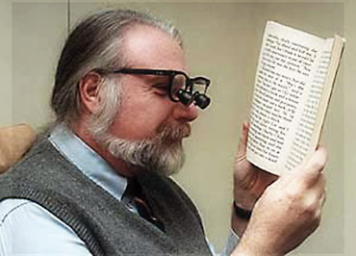
Who will benefit from the idea ?
Older people

Slide 6
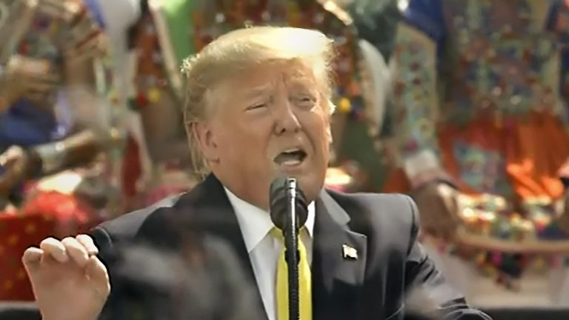
Who will benefit from the idea ?
Foreigners visiting India

Slide 7
Journey so far…
Part 1. Literature Review
Nijil Raj N, Anandu S Ram, Aneeta Binoo Joseph, Shabna S
Part 2. Data Collection
Collection of data from various sources
Adding some data from my side
Kushal Bhavsar , Keyurbhai Jani , and Rakeshkumar Vanzara
Part 3. Data Preparation
Label Images
Data Augmentation
Qian Zhang

Slide 8
Part 1. Literature Review - I
Currency Recognition Using Deep Learning - Qian Zhang (Auckland University of Technology in 2018)
Collected front and back sample images of 5NZD, 10NZD, and 20NZD as the sample denomination of the dataset.
Used CNN for feature extraction and Single Shot Multi Box Detector (SSD) for object detection and compared the results using MobileNet v1 and R-CNN in MATLAB.
He observed that CNN reaches 96.9%, the accuracy of MobileNet is 95.4%, and the accuracy of Faster RCNN is 95.8%.

Slide 9
Part 1. Literature Review - II
Deep Learning Based Indian Currency Detection for Visually Challenged using VGG16 - Nijil Raj N, Anandu S Ram, Aneeta Binoo Joseph, Shabna S (IJRTE 2020 )
Collected Indian currencies of Rs20, Rs50, Rs100, Rs200 & Rs500 having various security features as well, with an aim of classifying them as correctly as possible. They didn’t do any Object detection.
Used VGG16 (CNN) for feature extraction and compared results with earlier existing systems in MATLAB.
The resulting model produced an accuracy of 99.07% within just 10 epochs, compared to AlexNet based model which scored around 80%.
No. of Epochs | Accuracy
1 | 98.93
2 | 98.80
3 | 99.07
4 | 99.07
5 | 99.07
6 | 98.73
7 | 98.40
8 | 98.93
9 | 99.33
10 | 99.07

Slide 10
Part 1. Literature Review - III
Indian Currency Recognition from Live Video Using Deep Learning - Kushal Bhavsar , Keyurbhai Jani, and Rakeshkumar Vanzara (Ganpat University – 2020)
Gathered Data in the form of high quality images, with around 200 samples of each denomination.
Tried Faster RCNN(Restnet_50_coco model) which gave a accuracy of 87% but found that model was overfitting heavily.
Proposed a better & faster model could be determined in the future, since they faced issues like GPU limitations.
Label | # of training samples | # of testing samples
10_new_note | 201 | 50
10_old_note | 201 | 52
100_new_note | 204 | 47
100_old_note | 201 | 50
50_new_note | 202 | 51
50_old_note | 201 | 54
200_note | 210 | 55
20_new_note | 201 | 56
20_old_note | 200 | 51
2000_note | 201 | 48

Slide 11
Lets Compare – Data Collection
Qian Zhang
Front back shots of New Zealand Dollar
Low Quality Images
Nijil Raj N
Indian Denomination
Medium Quality
Proposal
Indian Denomination
Mixture of Qualities
Kushal Bhavsar
Indian Denomination
High Quality
Addition of Backgrounds

Slide 12
Lets Compare – Feature Extraction
Qian Zhang
Convolutional Neural Network
Nijil Raj N
VGG16 (CNN)
Proposal
Data Augmentation
CNN (Still to be researched)
Kushal Bhavsar
N/A

Slide 13
Lets Compare – Object Detection
Qian Zhang
Single Shot Multi Box Detector
Nijil Raj N
N/A
Proposal
Kushal Bhavsar
Restnet_50_coco (Faster RCNN)
Yolo v3

Slide 14
Lets Compare – Issues
Qian Zhang
MATLAB
Only 1% increase in accuracy
Nijil Raj N
MATLAB
Good Accuracy but took a lot of time
Proposal
Python
Less chances of Overfitting
Kushal Bhavsar
MATLAB
Model overfitted
Efficient Usage of GPU
Resource Exhausted

Slide 15
Part 2. Data Collection
The dataset includes various mixtures of new & old Indian currencies, with around 100-120 samples of each denomination.
Around 250 images containing abstract background are also included, to make the model more efficient.
Part of the data is collected from Kaggle, Google search and a small portion of high quality images are added from my side, just to make the dataset more wholesome.

Slide 16
Directory View
DATA
Validate
10
20
50
100
200
500
2000

Slide 17
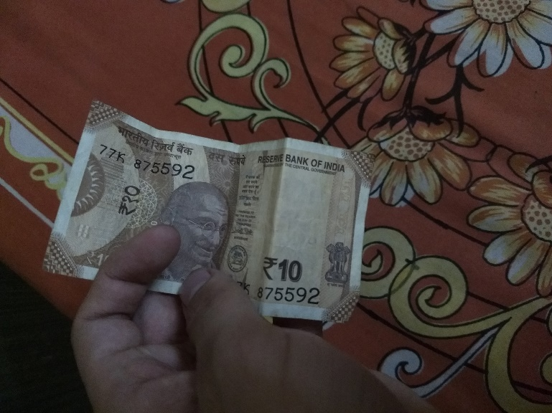

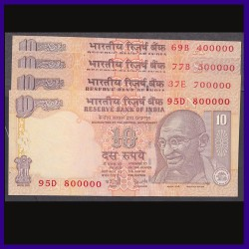
Sample Images
Google Images
Images Added from my side
Additional Background Images

Slide 18
Part 3. Data Preparation - Labelling
After sufficient data is being collected, images are labelled using LabelImg.
LabelImg is a graphical image annotation tool free sourced by PyPI.org.
After labelling, 80% of dataset will act as training data, while rest 20% will be used for validation.

Slide 19
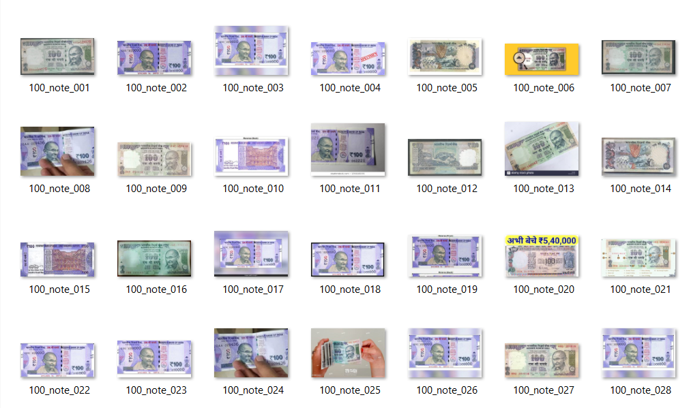
Sample Labels

Slide 20
Part 3. Data Preparation – Augmentation
Since, in real life, the notes are not as crisp as needed by the model, Data AUGMENTATION becomes a necessity.
Data augmentation in data analysis are techniques used to increase the amount of data by adding slightly modified copies of already existing data or newly created synthetic data from existing data. It acts as a regularizer and helps reduce overfitting when training a machine learning model.
Using Adobe Photoshop, and Keras, images are rotated on various angles, and some are even cropped, to make the training process more robust.

Slide 21
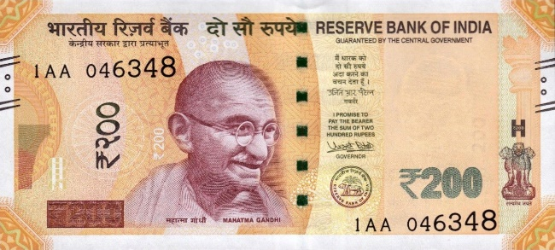
Sample – Augmented Images
Rotated at 45 Degrees
Normal Image
Flipped Horizontal
Flipped Vertical
Flipped Vertically Horizontal

Slide 22
Future Work
In the next phase, a CNN model will be used to extract important features from the dataset.
Then for object detection part, a deep-learning based object detection model like YOLOv3 can be used.
More augmentations to the dataset can be implemented if the data seemed insufficient for the model.

Slide 23
References
Deep Learning Based Indian Currency Detection for Visually Challenged using VGG16 - Nijil Raj N, Anandu S Ram, Aneeta Binoo Joseph, Shabna S, (International Journal of Recent Technology and Engineering (IJRTE) ISSN: 2277-3878, Volume-9 Issue-2, July 2020 969 Published By: Blue Eyes Intelligence Engineering & Sciences Publication Retrieval Number: B3955079220/2020©BEIESP DOI:10.35940/ijrte.B3955.079220 )
Indian Currency Recognition from Live Video Using Deep Learning - Kushal Bhavsar, Keyurbhai Jani , and Rakeshkumar Vanzara (U. V. Patel College of Engineering, Ganpat University, Mehsana 384012, Gujarat, India)
Indian Currency Recognition using Neural Network Pattern Recognition Tool - Mr.Viranchi N Patel1, Dr.Udesang K Jaliya2 and Mr.Keyur N Brahmbhatt (BVM Engineering College, V.V.Nagar, India )
Currency Recognition Using Deep Learning - Zhang Qian,Yan, Weiqi (Auckland University of Technology, Master of Computer and Information Sciences,2018-11-18T03:45:35Z)

Slide 24
Thank You for your Money…..

Slide 25
Collect Data from Various Sources
Data Annotation
Data Augmentation
Training CNN Model
Feature Extraction
Adding YOLO/Tiny-YOLO
Currency Detection
Currency Recognition

